Slide 1
Office 365 Development

Slide 2
Course Agenda
Introduction to Office 365 Development
Module 1: Deep Dive Apps for Office in Outlook
Module 2: Deep Dive Apps for Office in Word
Module 3: Deep Dive Apps for Office in PowerPoint
Module 4: Deep Dive Apps for Office in Excel
Module 5: Deep Dive into SharePoint Hosted Apps
Module 6: Deep Dive into Provider Hosted Apps
Module 7: Deep Dive into Security and OAuth
Module 8: App Lifecycle Management

Slide 3
Deep Dive into Office Word Add-ins

Slide 4

Agenda
Introduction to Word Add-ins
Developing Word Add-ins
Reading and Writing with Documents
Document Bindings
Packaging and Deployment
Changes with Word 2016

Slide 5















Vision
EXTEND OFFICE EVERYWHERE
CONNECT TO OFFICE 365 SERVICES
BUILD USING AN OPEN PLATFORM
Delve
z
Users and groups
Files
Mail
Calendar
My Apps
Video Portal
Contacts
Office Graph
Presentations
Documents
Spreadsheets
Lync
OneNote
Yammer

Slide 6
What is an Office Add-in?
Web application loaded inside an Office Application
Embedded inline or as task pane within documents, mails or appointments.
Works in Office Applications such as Microsoft Outlook
Works in Office Web Applications such as OWA
Works in mobile Office clients
Office application extensions using Web technologies
HTML 5 and CSS used to construct user interface
JavaScript and jQuery used to add executable logic and event handlers
Add-in can provided code to read/write content to/from Office documents
Add-in can call Web services hosted over Internet or running within local network
Notes:
An Office Add-in can be seen as a Web page loaded inside an Office Application. In some cases it will appear embedded inline within the document. In other cases it might appear as a task pane or within a message in Outlook. Note that the architecture for Office Add-ins has been designed to work in both Office Applications and Office Web Applications.
Office Add-ins allow Office applications to be extended in such as way so that they can leverage Web technologies such as HTML 5 and CSS for rendering user interface as well as JavaScript and jQuery to add behavior. When you write the JavaScript code for an Office Add-in, you can call REST APIs such as those added to SharePoint 2013 to retrieve and update data from across network.

Slide 7



Designing Office Add-ins - Shapes
Office Add-ins come in different shapes
Task Pane Add-in
Content Add-in
Mail Add-in
Mail Compose Add-in
Word Application
Excel Application
Outlook Application
Outlook Application
Document
Task Pane App
Document
Inbox
Selected Message
Inbox
New Message
Mail Compose
App
Reply | Reply All | Forward
To: xxx@yyy.com
Subject: Top secret stuff
app
Mail App
Content App
Message Body
Message Body
Notes:
When you begin to design an app, you must pick one of the three different shapes. You can create a document-based app as either a Task Pane App or a Content App. Alternatively, you can create a Mail App that targets Outlook and Outlook OWA.

Slide 8

Anatomy of an Office Add-in
Each Office Add-in is based on XML-based manifest
Manifest points to a Web page
Manifest defines the type of the Office Add-in
Manifest defines which Office applications it supports
Manifest defines required capabilities
Office Add-in
Office Add-in
Manifest
<XML>
Web
Page
HTML+JS
Notes:
Every App for Office must be distributed with an XML-based manifest which contains information about the app itself. For example, the app manifest contains an address to a Web page on the Internet which is used to load the app. The app manifest also includes information which indicates which Office applications it supports. The app manifest also defines the required capabilities which represent the set of permissions that the app needs in order to run and complete its work.

Slide 9
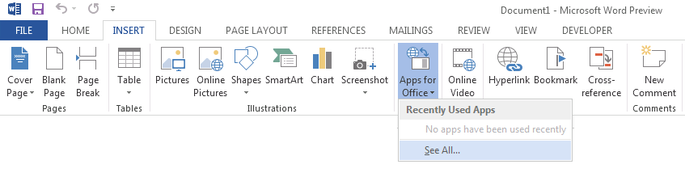
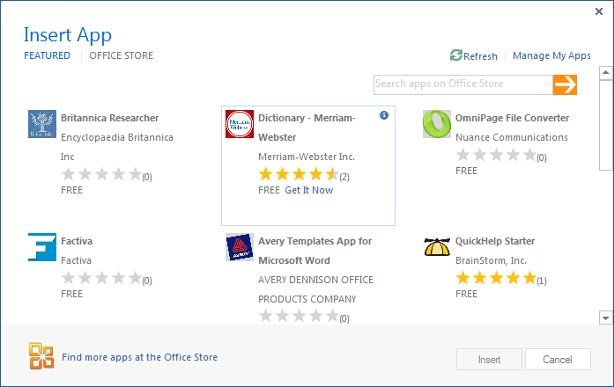
Adding an Office Add-in using the Insertion UI
Office Add-in insertion UI located in Ribbon inside Insert Tab
Dialog allows you to add and start Office Add-in
Notes:
Office 2013 applications provide users with the ability to discover add-ins and insert them. In Word and Excel, this support is included in the Ribbon inside the Insert Tab.
When you drop down the Apps menu from the ribbon, you can see recently selected add-ins. If you click "Select All", you will be prompted with a dialog that allows you to look in various app directories. Once you find an add-in you want to use, you can click the Start button to insert the app into the current document and start it up. After this, you can save the current document which will then include the add-in.

Slide 10
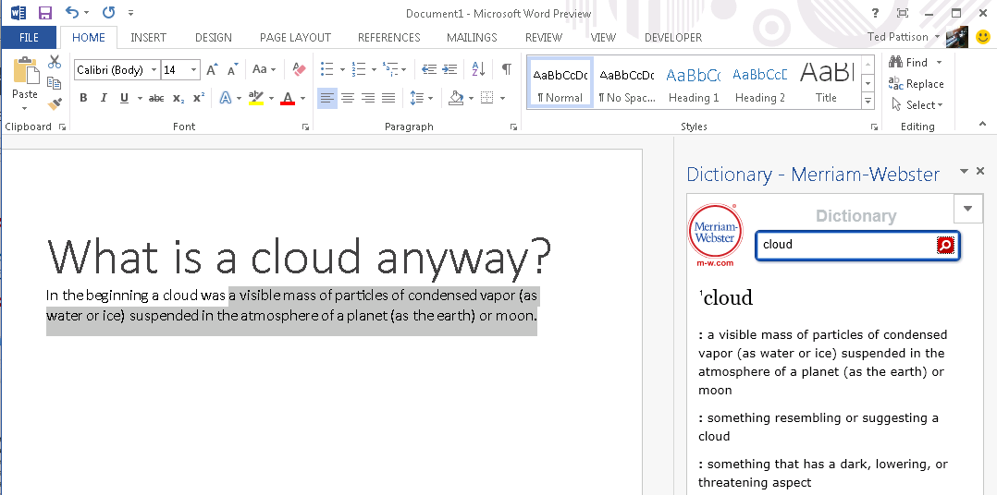
Task Pane Add-in User Experience
Familiar User Experience
Leverages familiar Office UI paradigm
Reference Information
Ideal for providing reference information associated with document.
Notes:
One reason to create a task pane add-in is that it provides Office users with a familiar user experience. For example Microsoft Word and Microsoft Excel have exposed many of its internal features using task panes so task pane add-ins provides a familiar Office UI paradigm.
Task pane add-ins are ideal for providing users with reference information. For example, a task pane add-in can perform Internet searches or lockups and provide reference information that can be inserted back into the current document.
This slide contains a screenshot showing the add-in after it has been inserted in a document. In Microsoft Word 2013. Different add-ins provide different user experiences. This add-in which is available for free on the Office Store allows the user to leverage the Marriam-Webster online dictionary lookup service to look up words and terms right from within Microsoft Word.

Slide 11
Developing Word Add-ins

Slide 12
Visual Studio Experience
Create new App for Office project
Create/design user interface for Web page
Enhance Web page with CSS and JavaScript
Set project properties in manifest
Run!
Notes:
This slide is pretty self-explanatory and demonstrates just how easy it is to create and test your first Office Add-in using Visual Studio. First, you will create a new project using one of the project templates in Visual Studio. Next, you will create the user interface for the app using HTML5 and CSS. After that, you add behavior to the add-in by writing JavaScript. Finally, you will update the XML file which serves as the add-in manifest. After that, you can press the {F5} key to test and debug your add-in.

Slide 13
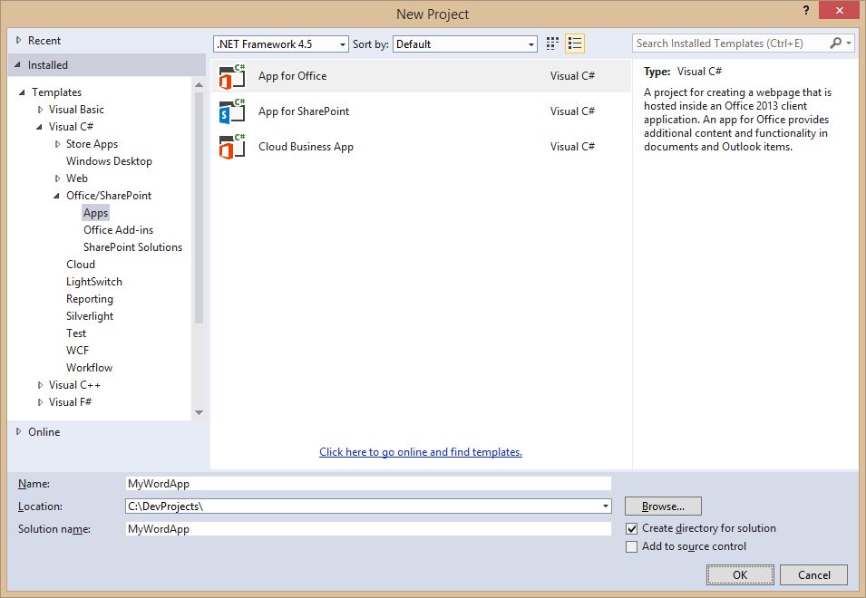
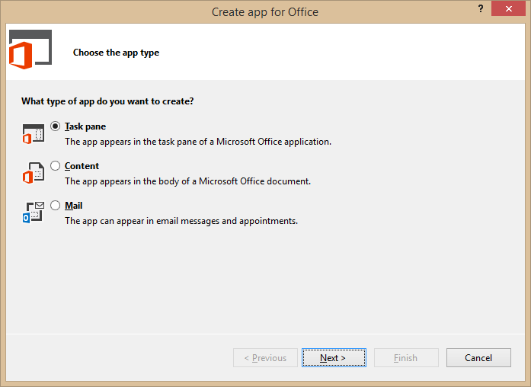
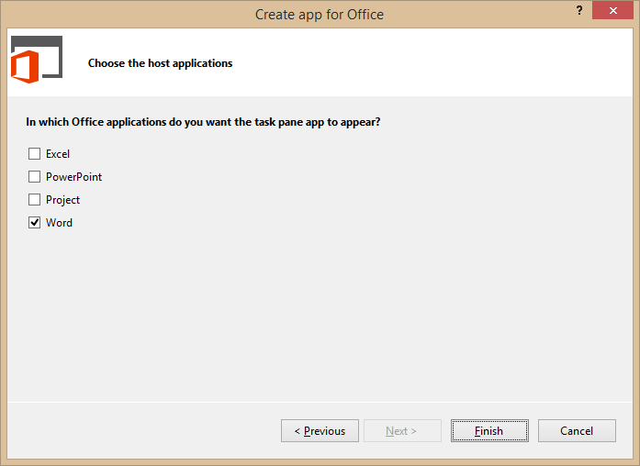
Create New Office Add-in
Create project based on App for Office 2013 project template
Dialogs appear and prompts you for specifics about the app
You must choose (1) the add-in shape and (2) which Office application are to be supported
Notes:
Visual Studio has a project template for Apps for Office. These project types gives you a starter project with a web page and manifest.

Slide 14
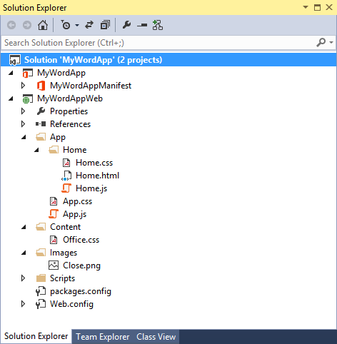
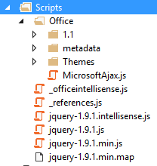
Office Add-in Project Structure
Office Add-in solution has two projects
Top project contains app manifest
Bottom project for remote web
Remote Web Project is ASP.NET Website
Contains HTML, CSS and JavaScript source files
Integration with jQuery library already included
Notes:
The slide shows the initial structure of a task pane add-in created with the Visual Studio.

Slide 15
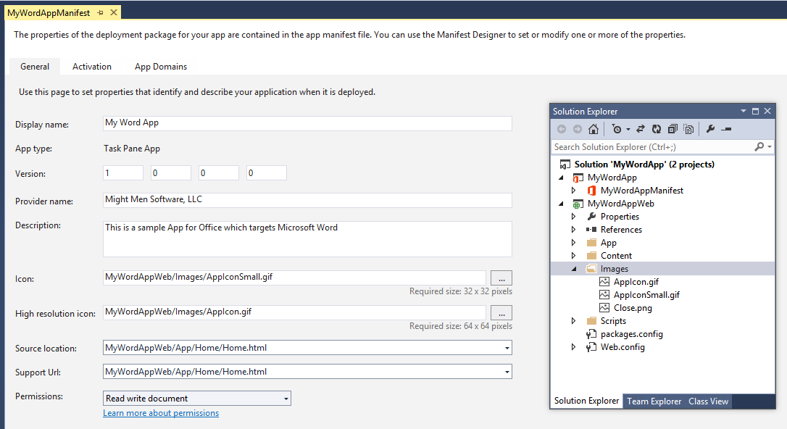
App Manifest Designer
Notes:
This slide shows the Visual Studio designer for an app manifest in a task pane app. It will look different for other types of Office Add-in.

Slide 16
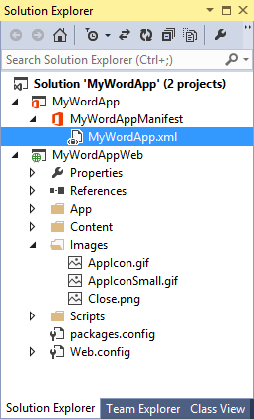
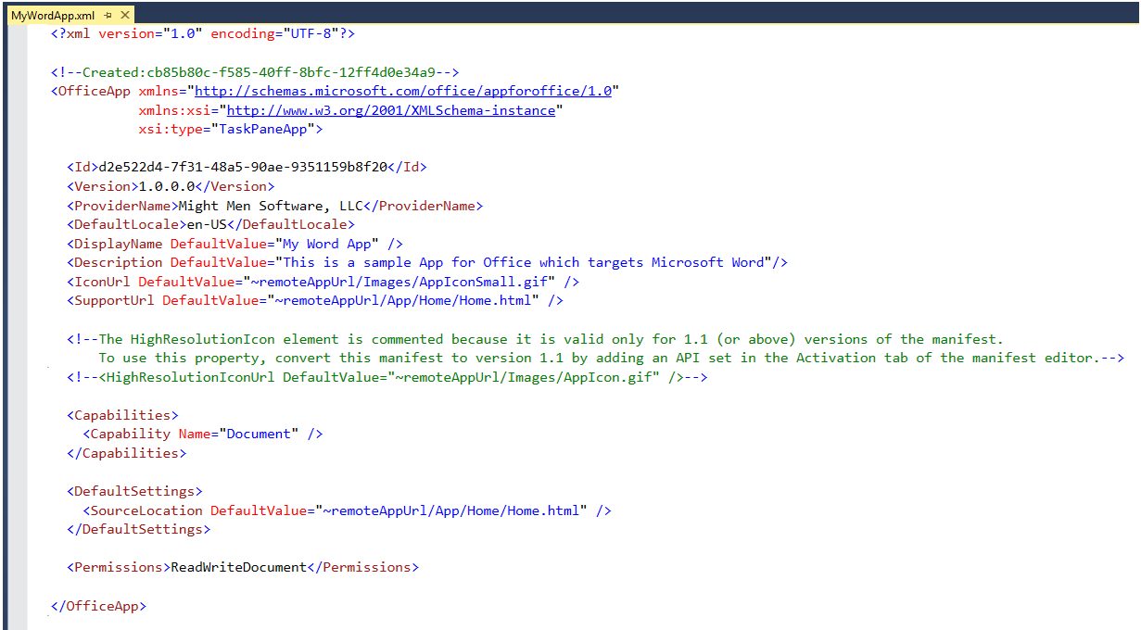
App Manifest - XML View
Notes:
There are times when it is also useful or necessary to examine or update the manifest in XML view. You can enter XML view by clicking the XML file in the Solution Explorer.

Slide 17
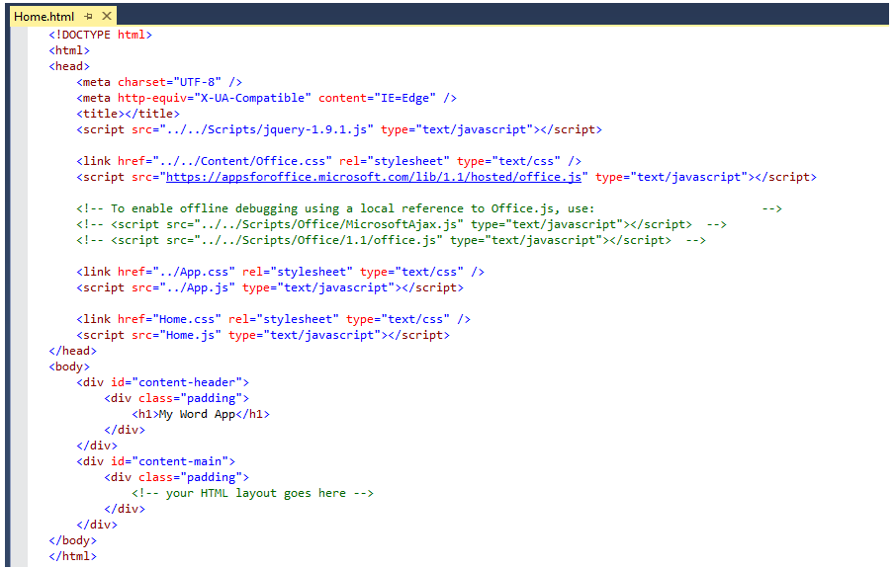
Create the HTML for a Web Page
Notes:
Each add-in has a source location which points to a entry point Web page somewhere on the Internet. Here is an example of a simple Web page that is used to load a task pane add-in. Note that this page must link to any required CSS files and JavaScript that will be adding styles or behavior behind the add-in. Visual Studio automatically adds the links for jQuery and ASP.NET AJAX. Also note that the page adds HTML elements which are often created with ids and/or classes.

Slide 18
Navigation and Links
DOs
Provide hyperlinks to open in browser
Design app to fit on one host page
Use iFrame with navigation bar if absolutely necessary
Consider ways to provide messages to users
DON’Ts
Expect hyperlinks to open in app window (blocked).
Send users to trapped pages via poor navigation trails
Use alerts
Notes:
This slides discusses what to use and what to avoid when designing an add-in.
Do provide hyperlinks within an to open Web pages in a new browser window. This makes it easier to design an app that fits cleanly on a single host page. Within the host page you can also use an iFrame to host content and provide a navigation bar if needed to change the contents of the iFrane using JavaScript. Also consider how your add-in will provide informational messages to the user. Typically this is done by adding a HTML element such as a div to the host page and dynamically writing text inside using JavaScript.
Here is a list of design issues to avoid. When creating hyperlinks, do not use <a> tags without a target attribute to open the link in a new window browser. You will find that such links are blocked by the Office UI if they attempt to take the user to a different domain. Also avoid links which navigate the user to pages which do not allow them to return to the start page as there is nothing similar to the back button inside the browser. Also, avoid interaction with the user using the poor man's technique of using the JavaScript alert function which has more restrictions inside an add-in than it does when used inside a browser.

Slide 19
Context Menus and Settings Controls
Full control of what is inside the Office Add-ins
Developer can override the right-click Context Menu
No Control to customize the Add-in container menus
Developer cannot customize Task Pane or Content/Chart object menu
Ability to save settings to “property bag”
Property bag values saved with the add-in within the document
With Mail Office Add-ins property bag values save within Exchange
Notes:
If you want an add-in to provide custom menus to the user, you should understand that you have control only of the users interface inside the add-in but not any UI elements outside. You can override the add-in context menu that appears at the upper right-hand corner of an add-in. However, when creating an add-in you have no control over customizing any other menus within Office add-ins.
Also remember that you have the ability to save custom properties as name values pairs using the settings API. These names value pairs are saved within the current document with task pane add-ins and with content add-ins. With mail add-ins these property values are saved within Exchange along with the host message or appointment.

Slide 20
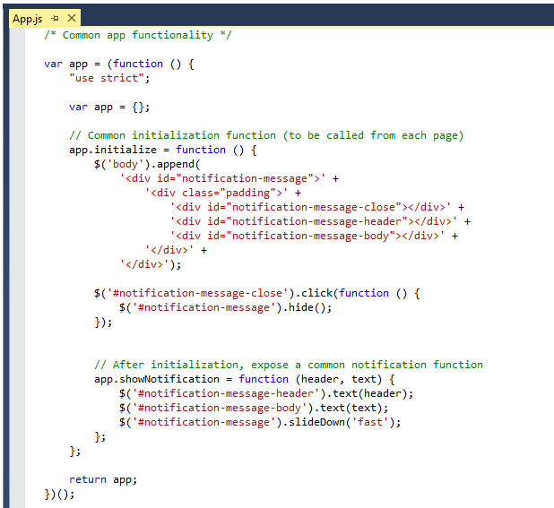
Code Added by Visual Studio
Notes:
JavaScript is the language that is used to add executable code and behavior to an Office Add-in. The JavaScript you write for an add-in will typically take advantage of the various JavaScript APIs supplied for Office.js and other JavaScript library files for specific Office applications such as Word, Excel and Outlook. In addition to the Office JavaScript APIs, the JavaScript code you write for an Office Add-in can also take advantage of the ASP.NET AJAX library as well as jQuery.
The Office JavaScript API provide a top-level named Office which provides an initialize function. By overriding this function as shown in the code above, you can write code that will automatically execute as the end of the initialization process when an add-in is started. A common approach is to register a jQuery document ready event handler inside this function.

Slide 21
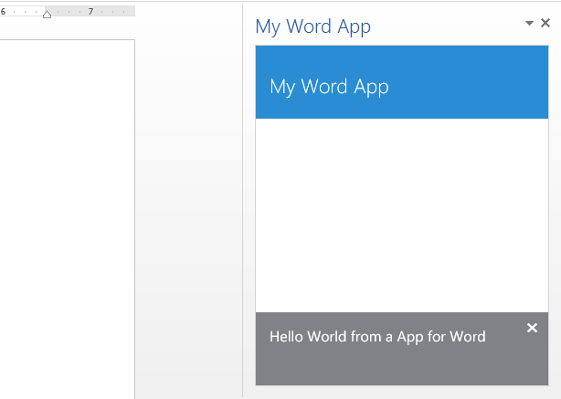
Test/Debug the Office Add-in using {F5}
When you press the {F5} key…
Visual Studio builds the app package and temporarily registers it
Visual Studio starts Microsoft Word and adds the add-in to new Word document
Notes:
When you press the {F5} with a Visual Studio project for an task pane add-in or a content add-in, Visual Studio automatically adds a registry entry to allow Office applications such as Word and Excel to discover the add-in which makes it possible to add it to a document.

Slide 22
demo
Creating an Office Add-in Targeting Microsoft Word

Slide 23
Reading and Writing with Documents

Slide 24
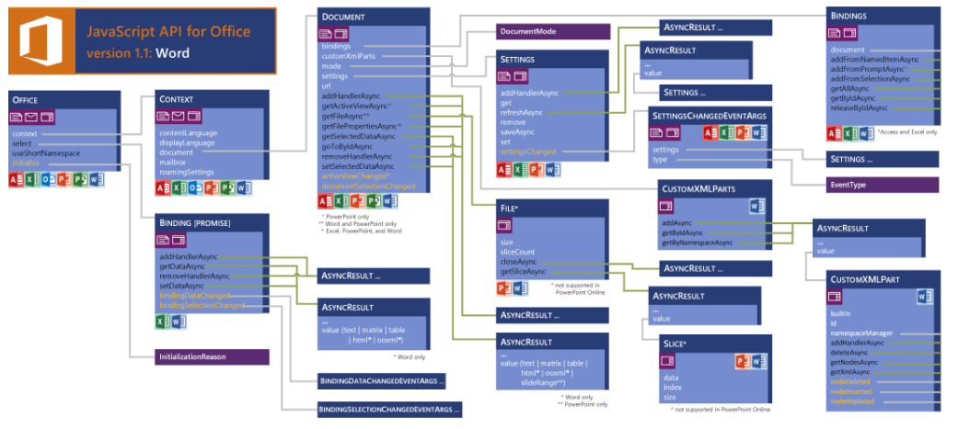
JavaScript API for Word Add-ins
See more at http://msdn.microsoft.com/en-us/library/office/fp142185(v=office.1501401).aspx

Slide 25
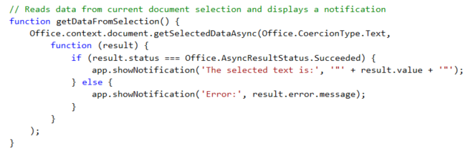
getSelectedDataAsync()
Use this function to read from document select
Notes:
The function getSelectedDataAsync() is used to read content from the selected region of the current Word document.

Slide 26
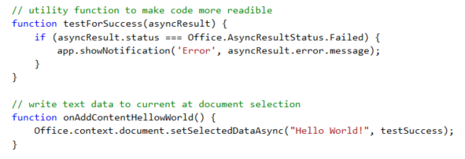
setSelectDataAsync()
Use this function to insert content into document
Notes:
The function setSelectedDataAsync is used to write content into the selected region of the current document. If there is no selected region, the content is added at the location of the cursor.

Slide 27
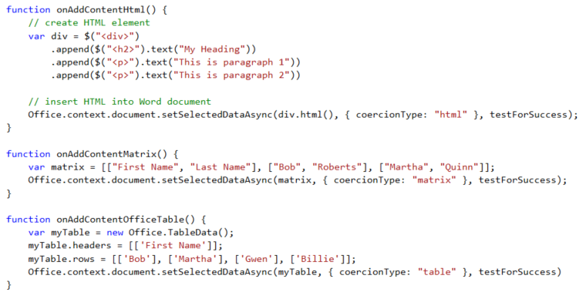
Coercion Types
Coercion types make it possible to read/write content in different formats
text - string value
html - HTML content
matrix - array of arrays
table - table of rows and columns
ooxml - Office Open XML format

Slide 28
demo
Writing Content To the Selected Region of a Word doc

Slide 29
Document Bindings

Slide 30
Bindings in Office Word Add-ins
Word supports data binding to content in document
Word currently only supports binding with Rich Text content control
Bindings created using content control Title which serves as ID
You can read and write bound content regardless of where selected region is
You can register event handlers to fire when user updates bound content
Notes:
Bindings are import because they make it so you can read and write to specific areas in a Word document without having to worry about what the selected region is

Slide 31
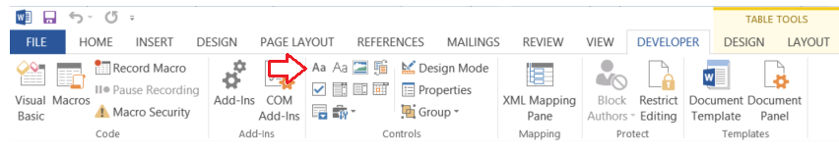
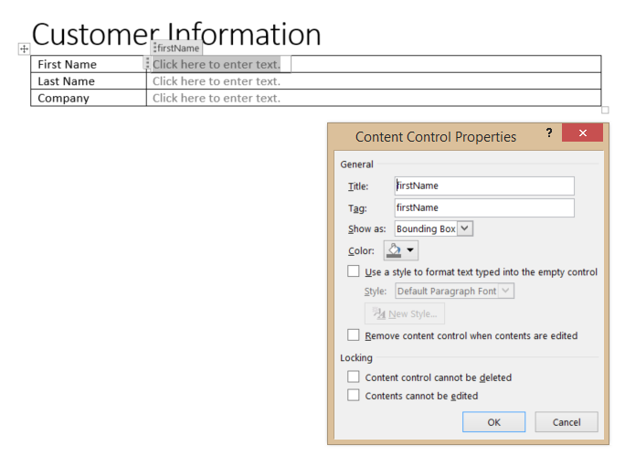
Adding Content Controls
Add Rich Text content control from Developer tab
Modify content control Title property to assign ID for binding
Notes:
To add content controls, you must enable and show the Word Developer tab. Then you can add one or more Rich Text content controls to a Word document for binding. Also note that you must assign each content control with a unique Title property because that is the ID you will use to bind to the content control.

Slide 32
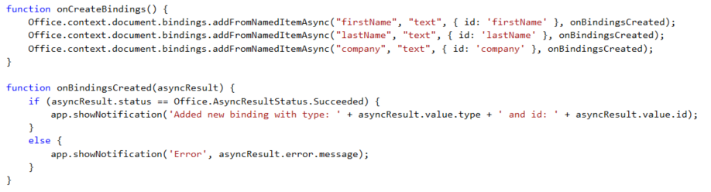
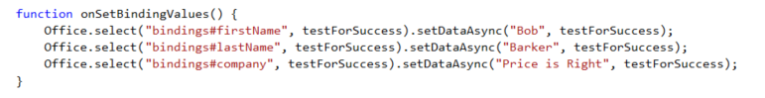
Adding Bindings in JavaScript
Notes:
The top code listing shows how to create bindings in JavaScript code using addFromNamedItemAsync. Note that the first parameter (e.g. "firstName") is used to indicate which content control you want to bind to. The third argument (e.g. { id: 'firstName' } is used to create the binding ID that will be used to retrieve the binding when call the Office.select function.
Note that the call to Office.select gets the binding using a syntax of "bindings#" followed by the ID of a registered binding.

Slide 33
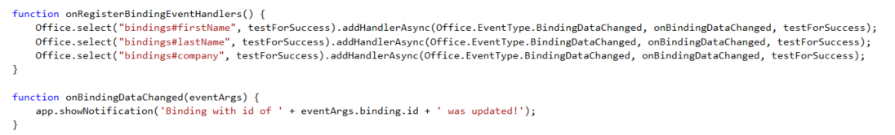
Adding Event Hander Bindings
Event handlers added using addHandlerAsync()
Callback function called automatically when user updates binding content
Notes:
This code shows how to register an event handler on a binding using the addHandlerAsync function.
The call also registers a callback function named onBindingDataChanged which is called automatically when user updates the bound content.

Slide 34
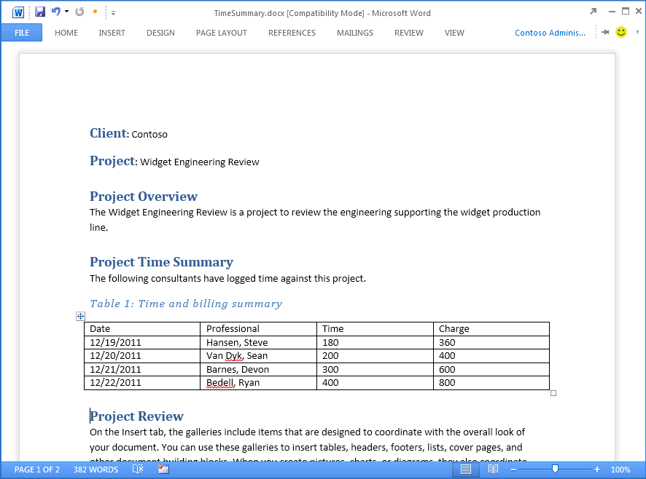
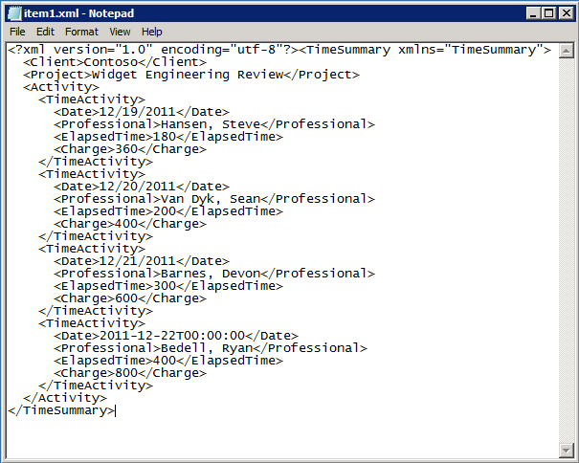


Open XML and Content Control Refresher
The TimeSummary document contains custom XML document
Inner XML document contains elements bound to Word Content Controls
Custom XML document can be modified/updated by your app
Custom XML document can be modified by user input
Word file structure
_rels
customXml
Content Controls mapped to custom XML part
docProps
word
Content Types
Notes:
Microsoft Word intorduced Content Controls in Office 2007. Content controls act as containers and user input controls for specific kinds of content. A valuable role of content controls is that they can be mapped to nodes within a custom XML part which is an XML document with custom content which is embedded within a Office document such as a DOCX file..
With Office 2013, there is a new content control for repeating sections. A Repeating Section content control provides the capability to bind to a collection of nodes which typically represent the many side on a one-to-many relationship as in the case where a single time summary document has many time activity entries.

Slide 35
Packaging and Deployment

Slide 36
Office Add-in Deployment
Steps
Deploy the remote web to Windows Azure or to other web server
Build app package which must include HTTPS URL of remote web
Upload app package to app catalog
Choosing An App Catalog
SharePoint App Catalog is preferred because it offers several advantages
File Share App Catalog deployment is a simpler, less-powerful option
Notes:
When it is time to deploy an add-in, the actual deployment is similar to standard web site because you must make the Web page for an app and the office supporting files available on a Web server. However, you must also publish the manifest to make the app discoverable for installation. IT admins can designate trusted App Catalogs via Global Policy Objects (GPO). Note that the manifests for Mail Add-ins must be uploaded to Exchange 2013 App Catalog.

Slide 37
SharePoint App Catalog
Designed for private corporate networks
Provides users with catalog of pre-screened and pre-approved apps
Often used to deploy apps developed in-house of by 3rd party ISV
Supports document-based apps (i.e. Task pane apps and Content apps)
SharePoint App Catalog hosted using Site Collection
Actual catalog is document library containing app manifests
Administrator can configure app for Office security settings
Notes:
SharePoint 2013 implements the App Catalog using a site collection created from a special site template. The app Catalog is designed for Office 365 and for private corporate networks in that it is available to only to users who have been granted access. It provides users with catalog of pre-screened and pre-approved apps. An App Catalog can be used to deploy apps developed in-house of by 3rd party ISVs. Note that the App Catalog in SharePoint supports document-based apps (i.e. Task pane apps and Content apps).
As already mentioned, the SharePoint App Catalog hosted using a SharePoint 2013 site collection. The actual catalog is simply a document library to which app manifests are uploaded. The administrator can configure app security settings that controls who can see and install the apps inside.

Slide 38
File Share App Catalog
Provides Simplest Means to Deploy Apps for Office
Does not require either SharePoint or Exchange
Apps for Office manifests copied to Windows File Share
Office Applications configured to read file share to discover Apps for Office
Client machine requires registry entry with file share path
Notes:
A File Share App Catalog provides the easiest way to deploy Apps for Office. It does not require either SharePoint 2013 or Exchange 2013. Instead, app manifest are simply copied to a Windows file share. Of course, the user desktops running Office Applications must be configured configured with the correct file share path to discover Apps for Office which can be done manually by user or centrally using GPO.

Slide 39
Changes with Word 2016

Slide 40
Office.js API Changes
Original Office.js release was very async focused
Challenging to do batch operations
Very transactional to interact with a document
New API more similar to the SharePoint CSOM

Slide 41
RequestContext()
All actions that target a Word document start by getting reference to the word context:
var context = new Word.RequestContext();
Contains queue of commands to be performed on doc
Bridge between Office Add-in & Word application
Execute operations in batches
Notes:
All actions that target a Word document start by using the client request context returned by the Word.RequestContext method. The client request context serves two major roles:
Contains the queue of commands that will be performed on the contents of a Word document.
Provide the bridge between the Office add-in and the Word application since they run in two different processes. The JavaScript runs in the user's browser within the task pane. Word runs in a different process, and in the case of Word Online, on a remote server cluster.

Slide 42
execAsync()
Submits request queue to word via the context
Returns promise object
var ctx = new Word.RequestContext();
var range = ctx.document.getSelection();
range.insertText("Hello World!", Word.InsertLocation.end);
ctx.executeAsync()
.then(function () {
console.log("Done");
})
.catch(function(error){
console.error(error);
});
Notes:
The Word JavaScript objects created in the add-ins are local proxy objects. Invoking methods and setting properties queues the set of commands in JavaScript, but does not submit them until executeAsync() is called. executeAsync submits the request queue to Word and returns a promise object, which can be used for chaining further commands. executeAsync runs each command in the order in which they were added to the queue. A best practice is to group related commands into a single executeAsync call.

Slide 43
load()
Specifies what collections, objects & properties are loaded into the object
ctx.load(object, loadOptions);
// or
object.load(loadOptions)
Notes:
The load method specifies which collections, objects, and properties will be loaded into the object model. You use the client request context to specify the load options and the object to load. There are two options for using the load method.

Slide 44
loadOption Object
Specifies which properties to load & how to page through collections
Select: specify properties you want to collect
text, style, font
Expand: load properties nested Word API objects & collections
font/color, paragraphs/text
Top: select only the first N number of items in the collection
Skip: skip the first N number of items in the collection
Notes:
You use the select option to load properties that are primitive types. You can use either a string or an object literal to specify which properties to load. For example, if you are going to make simple load statement, you don't need to create an object literal to specify the property.
You use the expand option to load properties that are in nested Word API objects and collections. Using the range object from the previous examples, we can load the paragraphCollection and the font object for the range by specifying the objects in the expand option. We identify which properties are returned in the select statement.

Slide 45
demo
Exploring Office.js in Word 2016

Slide 46
Related Documentation
MSDN: Create a task pane add-in with Napa Office 365 Development Tools
https://msdn.microsoft.com/EN-US/library/office/jj554660.aspx
MSDN: Word Add-ins
https://msdn.microsoft.com/EN-US/library/office/dn833112.aspx
JavaScript API for Office
https://msdn.microsoft.com/en-us/library/fp142185.aspx

Slide 47
Related Code Samples
Office Add-in Samples
http://dev.office.com/codesamples#?filters=office%20add-ins

Slide 48
Summary
Introduction to Apps for Word
Developing Apps for Word
Reading and Writing with Documents
Document Bindings
Packaging and Deployment
Changes with Word 2016

Slide 49



dev.office.com
Sign up
http://dev.office.com/getting-started
Explore
http://apisandbox.msdn.microsoft.com
Get trained http://dev.office.com/training

Slide 50


Feedback
Office 365 Network Share you best practices and join conversations https://www.yammer.com/itpronetwork
Stackoverflow Ask deep technical questions to a world-wide set of developers
http://stackoverflow.com/questions/tagged/ms-office
UserVoice Provide suggestions of what you want in future versions
http://officespdev.uservoice.com/

Slide 51

© 2012 Microsoft Corporation. All rights reserved. Microsoft, Windows, and other product names are or may be registered trademarks and/or trademarks in the U.S. and/or other countries.
The information herein is for informational purposes only and represents the current view of Microsoft Corporation as of the date of this presentation. Because Microsoft must respond to changing market conditions, it should not be interpreted to be a commitment on the part of Microsoft, and Microsoft cannot guarantee the accuracy of any information provided after the date of this presentation. MICROSOFT MAKES NO WARRANTIES, EXPRESS, IMPLIED OR STATUTORY, AS TO THE INFORMATION IN THIS PRESENTATION.

